Slide 1
How to Edit Web pages
By Zhipeng Liu

Slide 2
Who can edit the webpages
Authorize users can edit the webpages.
Chapter officers
SIG officers
SPWLA officers….

Slide 3
Get Authorization
Please send an email to webmaster@spwla.org with your:
Name.
Email.
Which pages you need to edit….
Justification. E.g. I am the chapter webmaster…
Wait for confirmation.

Slide 4
Log in and turn on quick edit

Slide 5
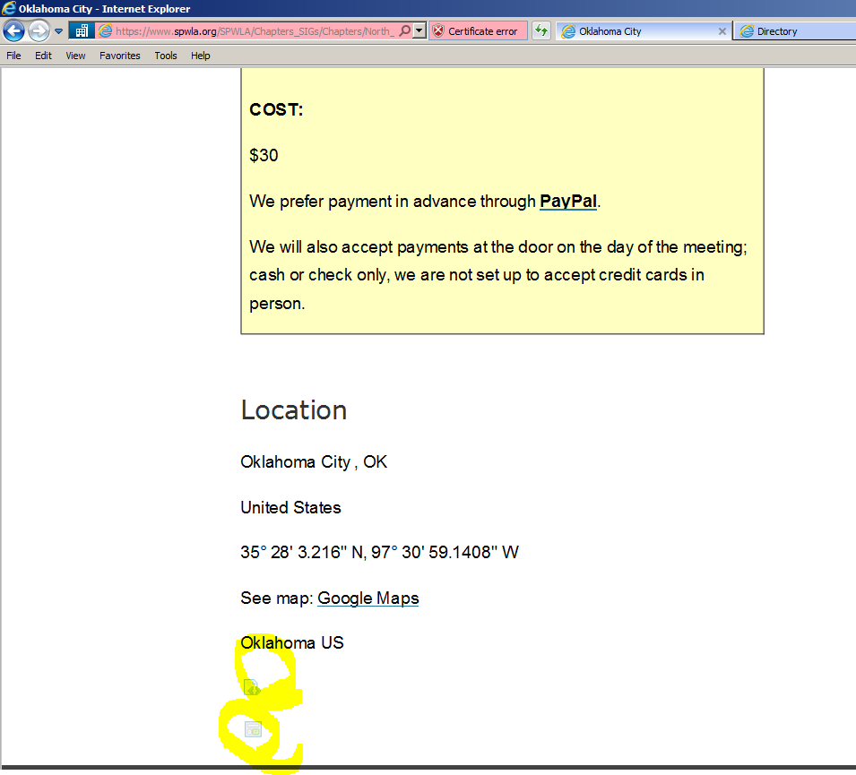
Edit Text vs Page Layout
Just change the text
Change Layout of page

Slide 6
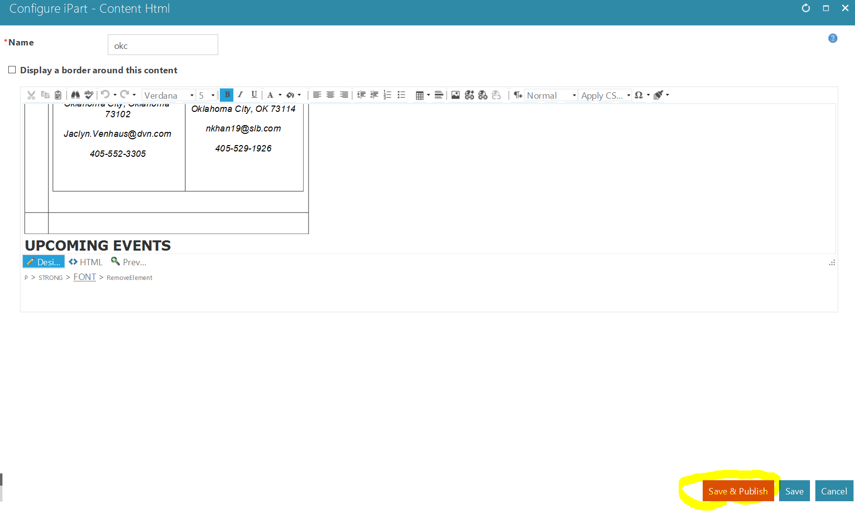
After Editting, Save and Publish

