Slide 1
Query Chapter and SIG members
By: Zhipeng “Z” Liu
VP-Infotech@spwla.org

Slide 2
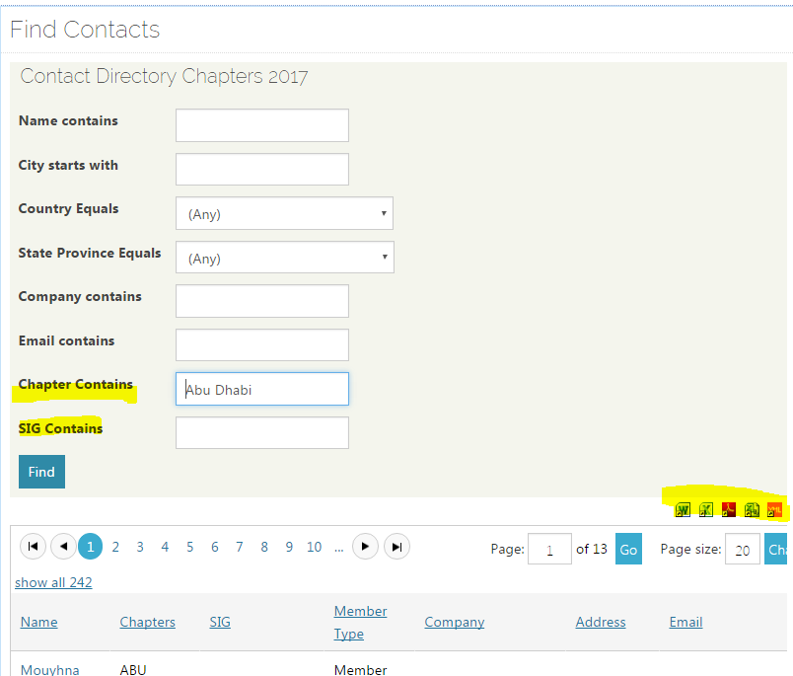
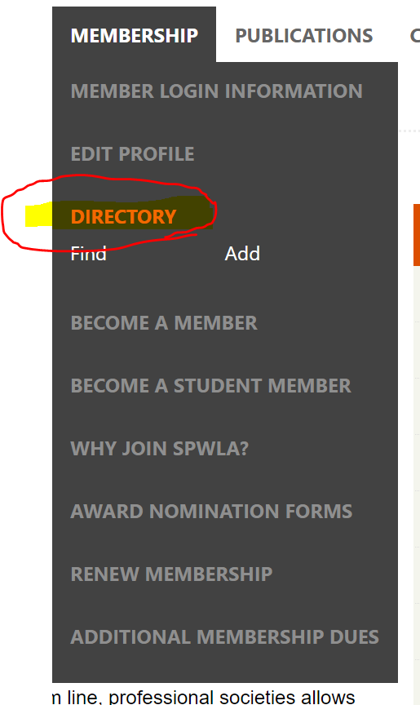
Member Directory
http://www.spwla.org/SPWLA/Membership/Directory/Find/SPWLA/Contact_Management/Directory.aspx
Query and save member list

Slide 3
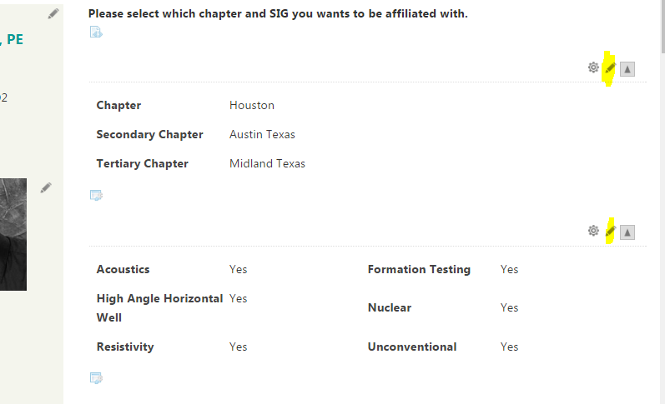
Managing Chapter and SIG Affiliation in Member Profile. Click the pen icon.

