Slide 1
How to link to a local file on IMIS server

Slide 2
Two options
Content file ipart. Easy, and quick.
FTP. Good for large file and hyperlink.

Slide 3
Content File Ipart

Slide 4
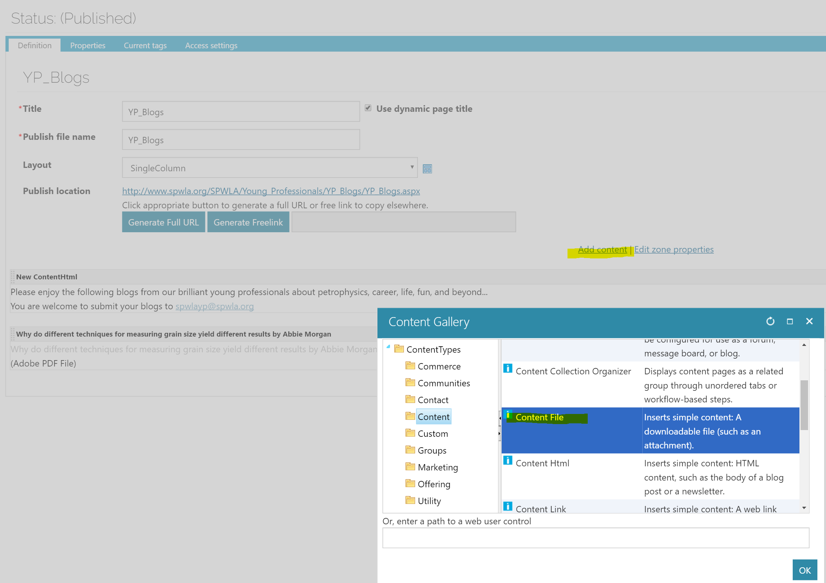
Add content file ipart

Slide 5
Configure the ipart and upload a file. Save and publish.

Slide 6
FTP

Slide 7
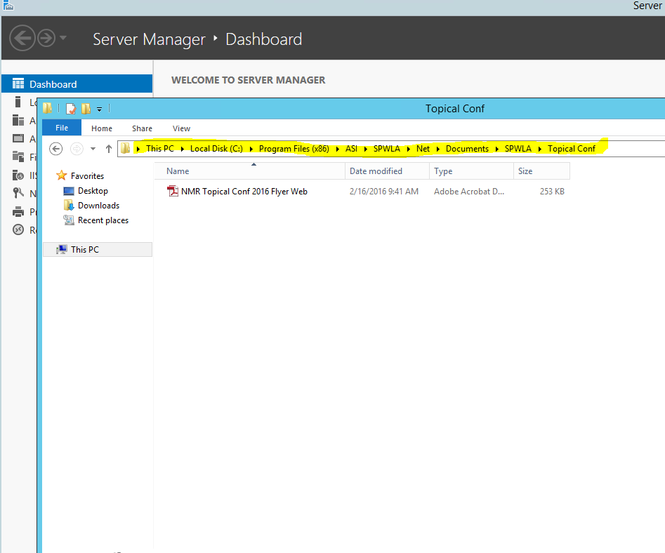
For SPWLA office staffs: RDP Put the file on C:\Program Files (x86)\ASI\SPWLA\Net\Documents folder and sub folders.

Slide 8
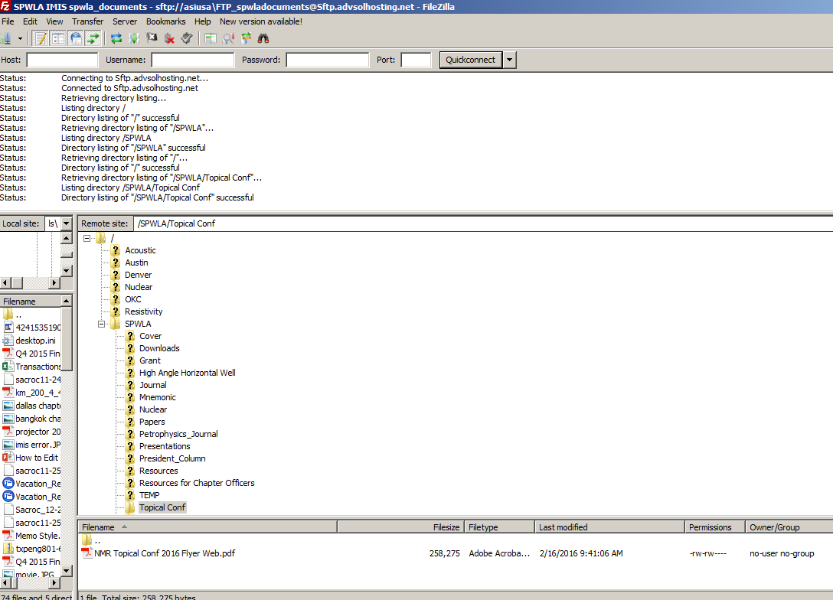
For Chapter officers. use FTP to upload the file. Please contact Zhipeng Liu for FTP info

Slide 9
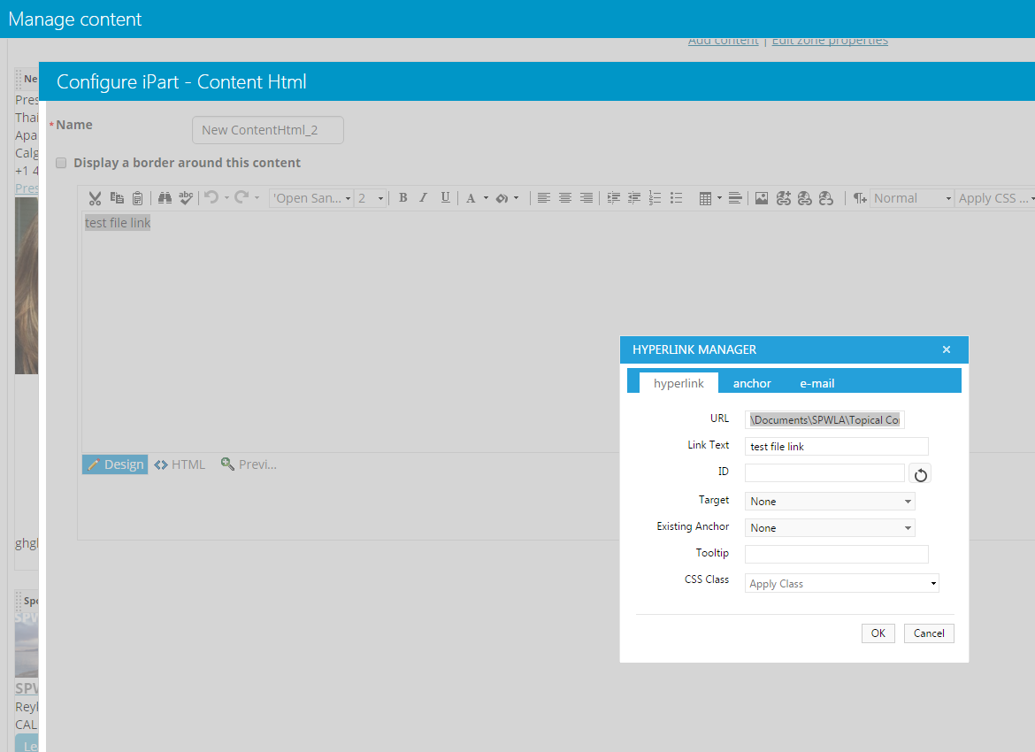
Link it to \Documents\SPWLA\Topical Conf\NMR Topical Conf 2016 Flyer Web.pdf

Slide 10
It should work see example at http://www.spwla.org/SPWLA/Z_TEST/test_page1.aspx

Slide 11
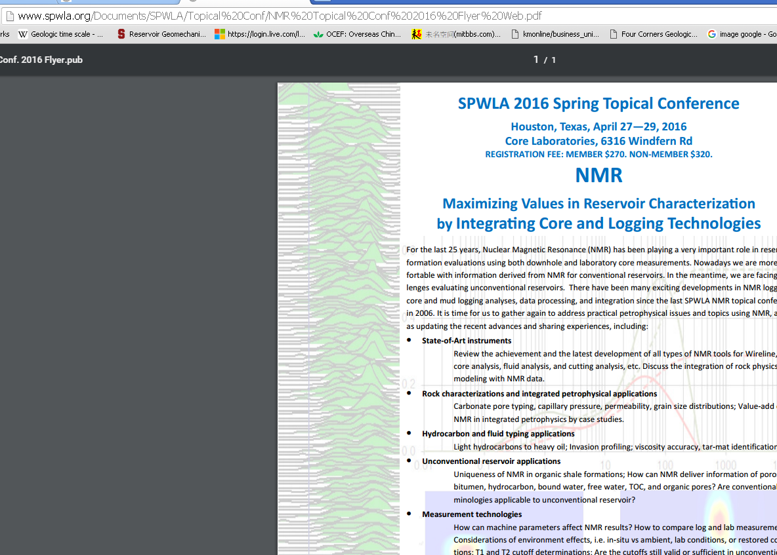
The full path to the file is at http://www.spwla.org/Documents/SPWLA/Topical%20Conf/NMR%20Topical%20Conf%202016%20Flyer%20Web.pdf

